Slide 1

Maharashtra Institute of Technology Department of Computer Engineering

Slide 2
Connect4 Game using Prolog
Artificial Intelligence and Robotics
Members :
Kakad Rishikesh 402075
Vaibhav Gole 402062
Yoganand Kanhed 402077

Slide 3
Problem Statement
Implement A-star algorithm for four connect game.

Slide 4
Tool used for implementation
SWI-PROLOG:
SWI-Prolog offers a comprehensive free Prolog environment.
Since its start in 1987, SWI-Prolog development has been driven by the needs of real world applications.
SWI-Prolog is widely used in research and education as well as commercial applications.

Slide 5
Algorithm steps:
Initialize the open list
Initialize the closed list put the starting node on the open list (you can leave its f at zero)
While the open list is not empty
find the node with the least f on the open list, call it "q“
pop q off the open list
generate q's 8 successors and set their parents to q
if successor is the goal, stop search successor
push q on the closed list end (while loop)

Slide 6
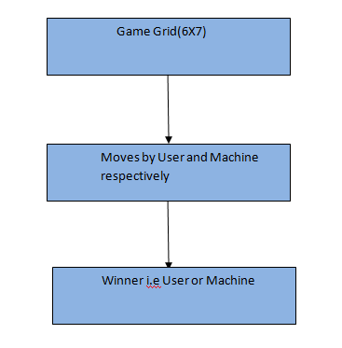
Flowchart:

Slide 7
USER CLASSES AND CHARACTERISTICS
There are 2 kinds of users for the proposed system.
Machine:
Machine is the opponent for the user who plays the game
End User/Customers:
The end user will be the one who plays with the machine.

Slide 8
Conclusion:
The Astar algorithm is implemented for the four connect game.

Slide 9
Applications and Future Scope
In pathfinding operation
In graph traversal
Parsing using stochastic grammers in NLP
Information search with online learning.

Slide 10
References
Dahl, V., “Logic Programming as a Representation of Knowledge,”​IEEE Computer, Vol. 16, October, 1983.
The sites referred are:
en.wikipedia.org http://www.swi-prolog.org/ http://www.learnprolognow.org/
http://kti.mff.cuni.cz/~bartak/prolog/
https://en.wikipedia.org/wiki/Backward_chaining

